Slide 1
JESUSCHRIST!
PEAK LOAD MANAGEMENT SYSTEM

Slide 2
1. PLMS ARCHITECTURE
5. PLMS CLASSIFICATION
A Time intervals
- Daily Load Curves (hourly/half hourly)
- Seasonal (Winter/Summer/monsoon)
- Annual Load Curves
FORMAT==> TABULAR & CHART
B User Classes
- Residential
- Industries
- Commercials
- Huts
- Agriculture
FORMAT==> TABULAR & CHART
C UTILITY CATEGORY
- LIGHTING RELATED
- MOTOR RELATED
- PUMPING RELATED
- HEATING RELATED
- AC RELATED
FORMAT==> TABULAR & CHART
6. PLMS Evaluation
- Pre & Post programme metering
- Analysis of Customer Billing data
- Engineering analysis
- Questionnaires & Survey
- Statistical Modelling- demographics, economics
FORMAT==> TABULAR
2. PEAK LOAD SUPPLY REGIONS WISE
- Region Wise
- Zone Wise
- City Wise
FORMAT==> TABULAR & CHART
7. PLMS ANALYSIS:
- Analysis of System Load Curve
- Economic analysis from different perspectives
- Quantification and trend Analysis
- peak shortage
- Variation of monthly average energy
- PLMS - PEAK LOAD VS SEGMENT MAPPING
FORMAT==> TABULAR & CHART
3. PARETO ANALYSIS - PEAK LOAD MANAGEMENT
- TAMILNADU REGION WISE
- SEGMENTWISE - RICHA WISE
- RICHA - ENDUSER WISE
FORMAT==> TABULAR & CHART
4. Load Management Options
- Direct Load Control (DLC)
- Cycling
- Payback control
- Interruptible Load Control (ILC)
- Utility
- Time of Use (TOU) Tariffs
- Graph
FORMAT==> TABULAR & CHART
8. PLMS ENERGY SAVINGS
- Least Cost Curve
- CRITICAL Factors
FORMAT==> TABULAR & CHART
9. PLMS UTILITY MODEL - DONE
- Generalised lighting end use model
FORMAT==> TABULAR & CHART
10. AI MEASURE
- COST OF ENERGY SAVED
- PEAK SHAVING
- LOAD SHEDDING
FORMAT==> TABULAR & CHART

Slide 3
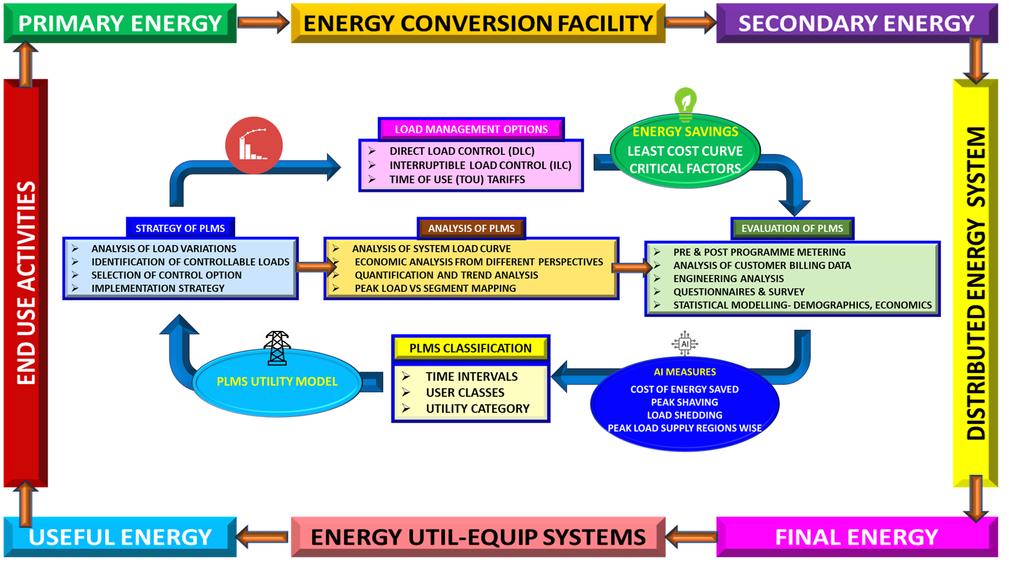
PLMS ARCHITECTURE

Slide 4
THANK YOU VERY MUCH!

